Slide 1




i-Wish: Granting Wishes, Building Connections
JavaFX Application
A Collaborative Gift-Giving Experience

Slide 2


ABOUT THE APPLICATION
We recognized the challenges in traditional gift-giving—deciding what to gift, the risk of duplicates, and the overall complexity. That's why we came together to create i-Wish, an application designed to simplify the entire process and bring joy to both the wish-maker and the contributors.
In a world where traditional gift-giving can be challenging, i-Wish brings friends together to make wishes come true.

Slide 3
The i-Wish client, powered by JavaFX, offers users an intuitive interface to create wishlists, connect with friends, and track gift contributions. It provides a user-friendly experience, making collaborative gift-giving effortless and engaging.
01 - CLIENT
The i-Wish server is the central hub managing communication between users, the client, and the database. It ensures real-time collaboration, handles requests securely, and facilitates seamless interaction, contributing to the collaborative and efficient functionality of i-Wish.
02 - SERVER
The i-Wish database is a sophisticated and relational storage system. It organizes user data, wishlists, and contributions, ensuring data integrity and scalability. It acts as a reliable repository, supporting the collaborative spirit of i-Wish through a well-organized data structure.
03 - DATABASE

Slide 4

ARCHITECTURE

Slide 5






Client1
Server
Database
Data access layer
Client2
Client3
Clients send requests
Server handle requests and connect to the DB through Data Access Layer

Slide 6
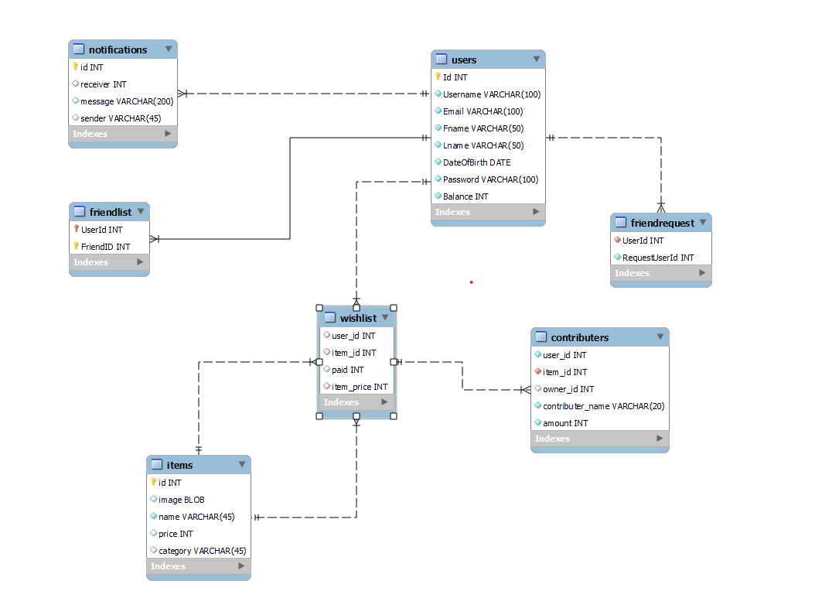

Slide 7


GUI

Slide 8







APPLICATION FEATURES
Database Integration
Contribution Tracking
User-Friendly Design
Robust database architecture stores and manages user data, wishlists, and contribution records efficiently, ensuring data integrity and scalability.
Real-time updates on contributions, ensuring transparency and coordination among friends.
Intuitive design for a seamless and enjoyable user experience.
Wishlist Creation
Collaborative Gift-Giving
Data Security
Users can easily create personalized wishlists, adding items they desire.
Friends can come together to contribute and fulfill each other's wishes, enhancing the joy of giving.
Protected user information and ensure a safe and trustworthy platform for collaborative gift-giving.

Slide 9
APPLICATION TOUR

Slide 10
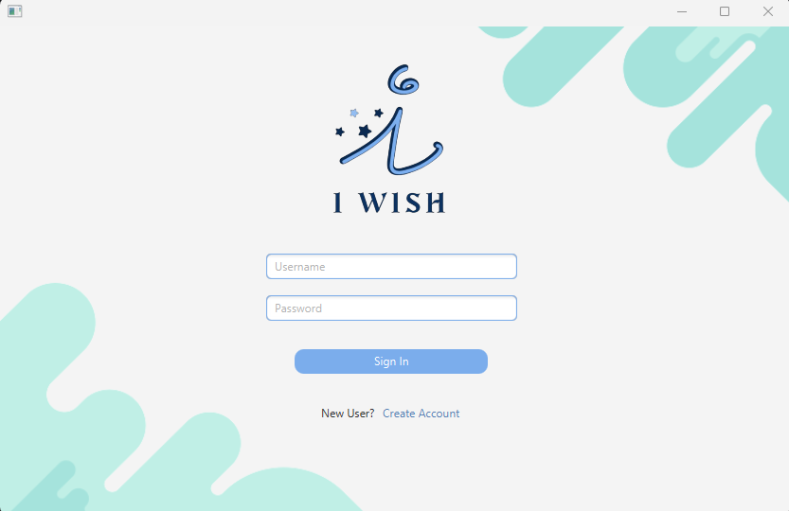
LOGIN SCENE

Slide 11
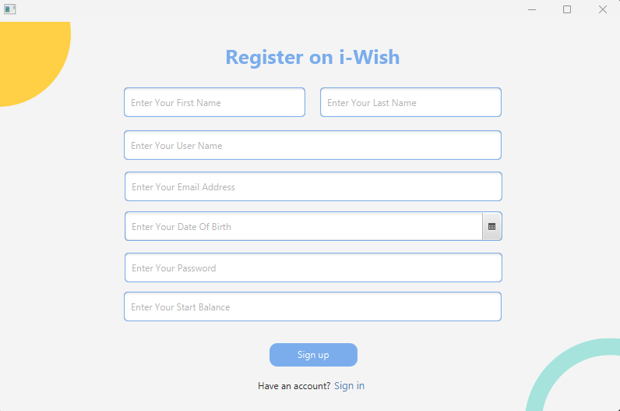
REGISTRATION SCENE

Slide 12
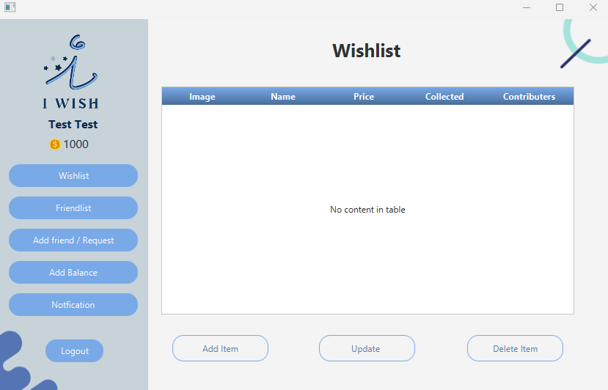
MAIN PAGE SCENE

Slide 13
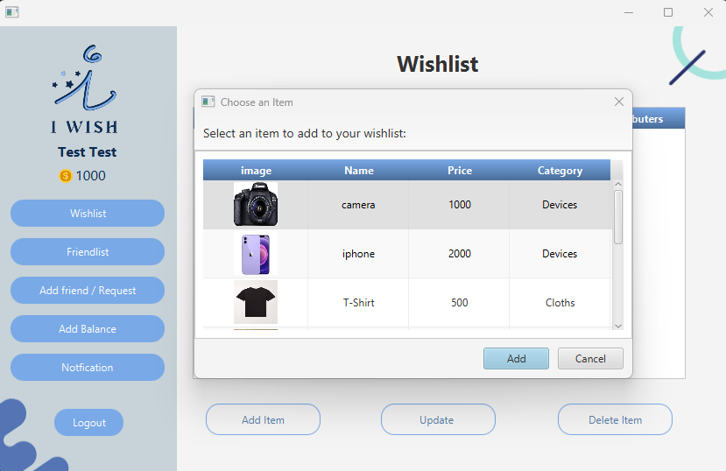



WISHLIST SCENE
2
3
1

Slide 14
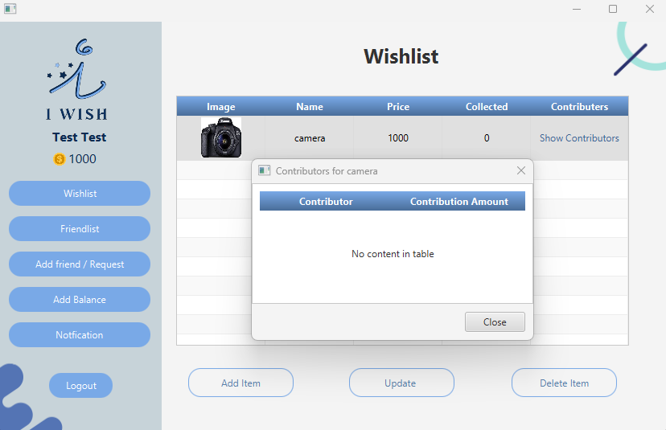

CONT’D

Slide 15
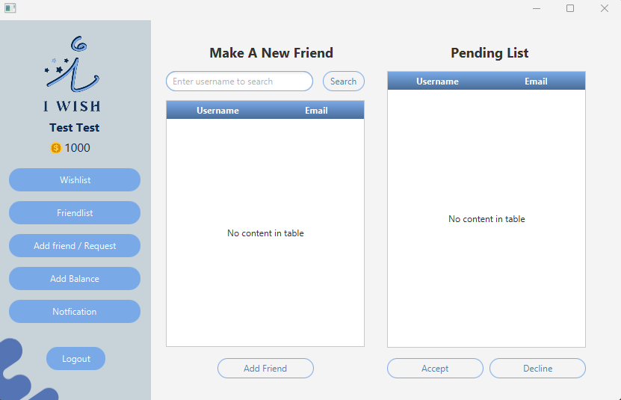
ADD/REQUEST FRIENDS’ SCENE

Slide 16
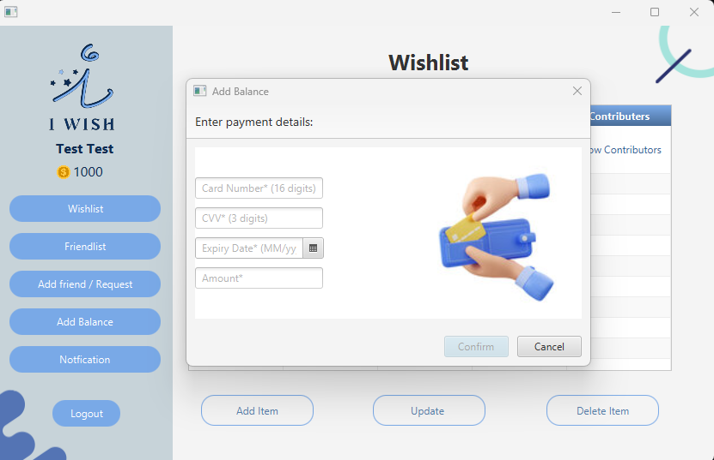
ADD BALANCE SCENE

Slide 17
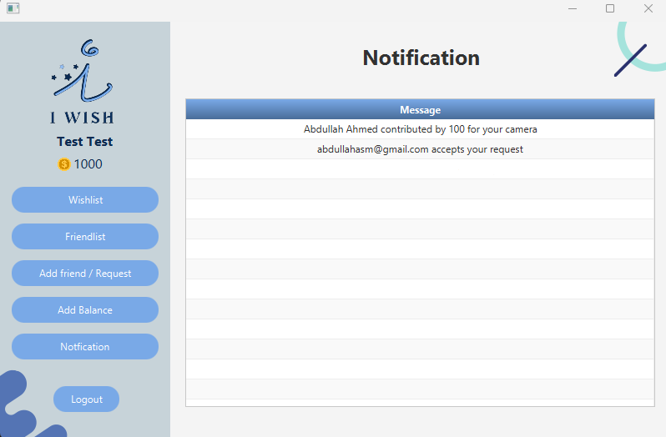
NOTIFICATION SCENE

Slide 18
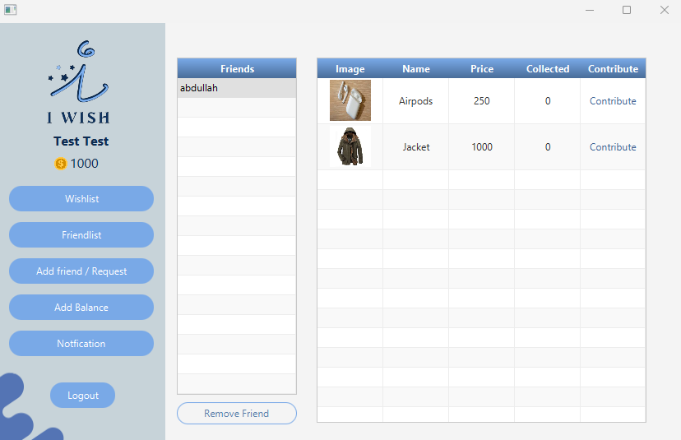
FRIEND LIST SCENE

Slide 19
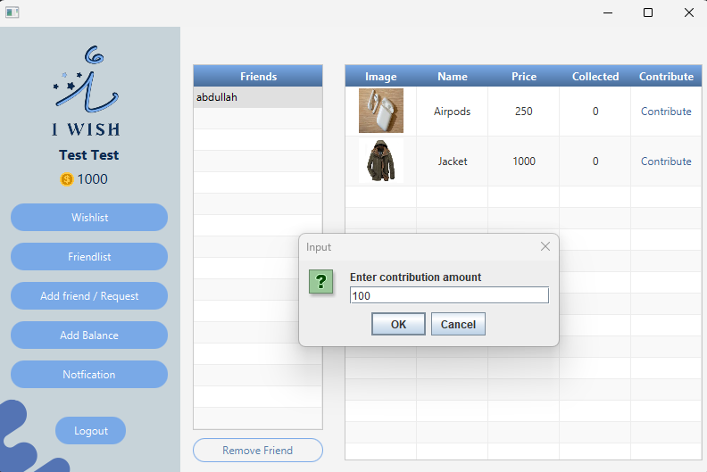
CONT’D
2
1
3

Slide 20

SUMMARY
i-Wish is a collaborative gift-giving application designed to simplify and enhance the joy of sharing presents among friends. With a user-friendly JavaFX interface, users can effortlessly create personalized wishlists and invite friends to contribute. The application facilitates real-time collaboration, providing transparency through contribution tracking. Powered by a robust client-server architecture and an efficient database, i-Wish offers a seamless and secure platform for friends to come together, celebrate connections, and turn wishes into shared moments of joy.

Slide 21
THANK YOU

